Slide 1
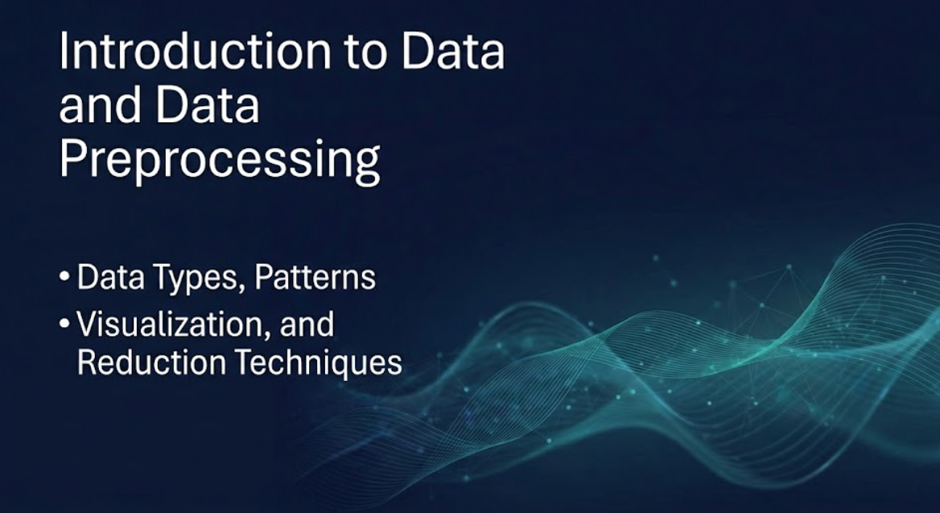
Introduction to Data and Data Preprocessing
-Data Types, Patterns, Visualization, and Reduction Techniques
EFFORTS BY:
DIVYA TRIPATHI
Student of BTECH CSE (CORE)-I
RA2311003030547
3rd Year/ 6th Sem

Slide 2
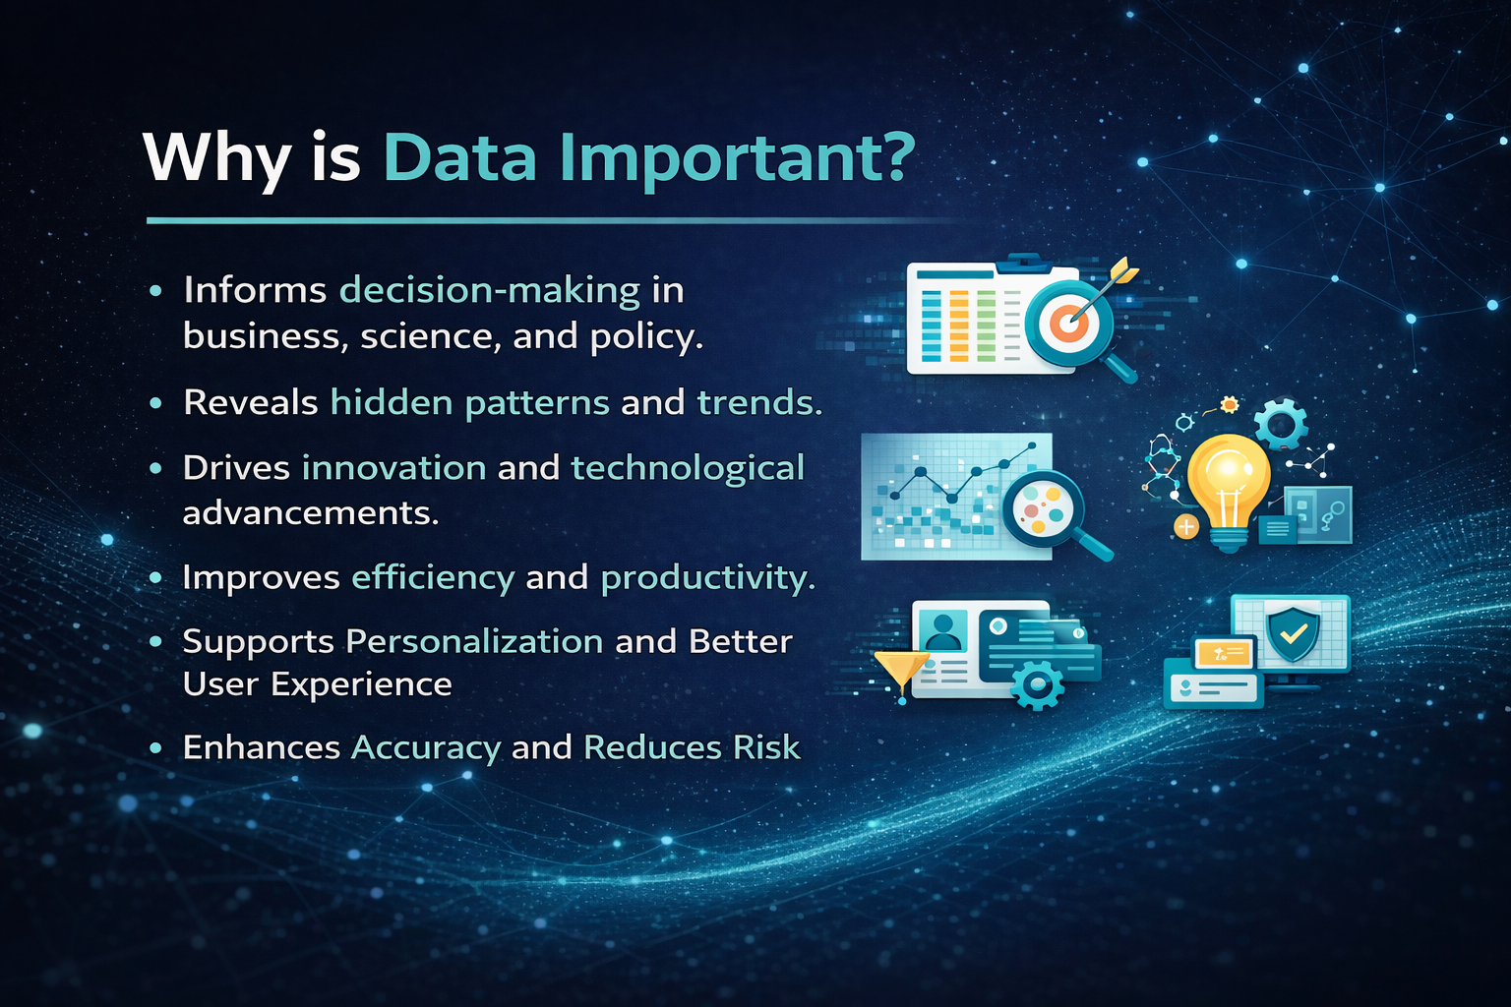
Understanding Data: The Foundation of Insight
Data, in its simplest form, refers to a collection of facts, figures, and statistics gathered for reference or analysis. In the digital age, data is ubiquitous, generated every second from countless sources.
Why is Data Important?
Informs decision-making in business, science, and policy.
Reveals hidden patterns and trends.
Drives innovation and technological advancements.
Improves efficiency and productivity.
Supports Personalization and Better User Experience
Enhances Accuracy and Reduces Risk

Slide 3




Exploring the Kinds of Data
Data can be classified into various types, each requiring different analytical approaches. Understanding these distinctions is crucial for effective data processing.
Numerical Data
Categorical Data
Structured Data
Unstructured Data
Quantitative measurements such as age, height, temperature, or sales figures. Can be discrete (countable) or continuous (measurable).
Represents characteristics or qualities that can be divided into groups, e.g., gender, country, product type.
Highly organised and formatted, typically found in relational databases (e.g., spreadsheets, SQL tables).
Lacks a predefined format, making it challenging to process (e.g., text, audio, video, emails, social media posts).

Slide 4
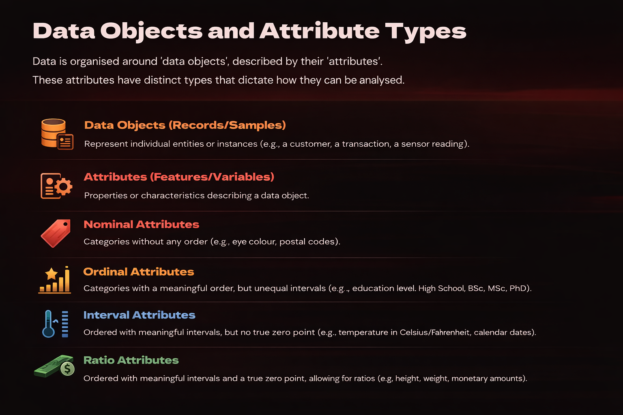
Data Objects and Attribute Types
Data is organised around 'data objects', described by their 'attributes’.
These attributes have distinct types that dictate how they can be analysed.
Data Objects (Records/Samples)
Represent individual entities or instances (e.g., a customer, a transaction, a sensor reading).
Attributes (Features/Variables)
Properties or characteristics describing a data object.
Nominal Attributes
Categories without any order (e.g., eye colour, postal codes).
Ordinal Attributes
Categories with a meaningful order, but unequal intervals (e.g., education level: High School, BSc, MSc, PhD).
Interval Attributes
Ordered with meaningful intervals, but no true zero point (e.g., temperature in Celsius/Fahrenheit, calendar dates).
Ratio Attributes
Ordered with meaningful intervals and a true zero point, allowing for ratios (e.g., height, weight, monetary amounts).

Slide 5




Uncovering Patterns in Data
Data mining techniques are employed to discover insightful patterns within vast datasets, revealing relationships that might otherwise remain hidden.
Trends
Associations
Long-term movements or directions in data (e.g., increasing sales over time, rising temperatures).
Relationships between different data items (e.g., customers who buy product A also buy product B).
Clusters
Outliers
Groups of similar data objects (e.g., customer segmentation based on purchasing behaviour).
Data points that deviate significantly from the majority of the data (e.g., fraudulent transactions, unusual sensor readings).

Slide 6
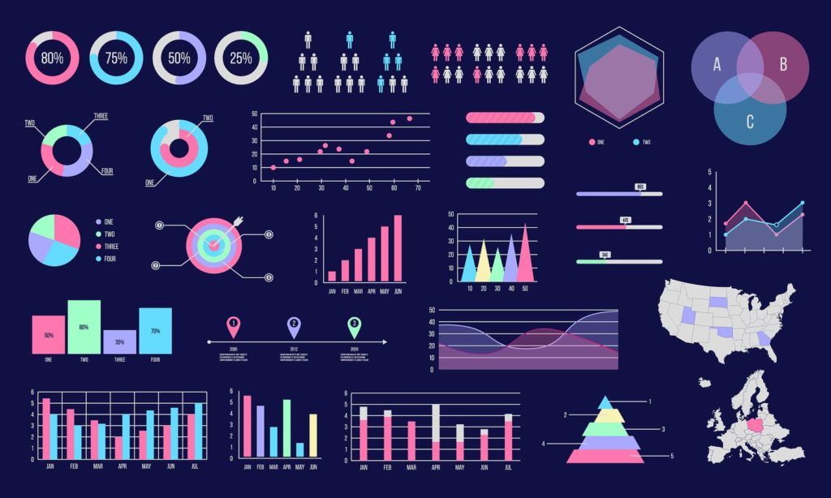
Data Visualization: Making Sense of the Unseen
Data visualization is the graphical representation of information and data. By using visual elements like charts, graphs, and maps, data visualization tools provide an accessible way to see and understand trends, outliers, and patterns in data.
Importance
Simplifies complex data by presenting it in visual formats like charts and graphs.
Improves understanding by making patterns and trends easy to identify.
Enables faster decision making through quick visual insights.
Reveals relationships and correlations between different data variables.
Helps detect outlier and anomalies that may not be visible in raw data.
Enhances communication of data insights to both technical and non-technical audience.
Increases data engagement by making information more interactive and visually appealing.
Common Techniques
Bar Chart
Line Graph
Pie Chart
Histogram

Slide 7






Data Preprocessing: Refining Raw Data
Data preprocessing is a critical step in the data mining process that transforms raw data into an understandable and efficient format for analysis. It addresses inconsistencies, noise, and missing values.
Data Cleaning
Data Integration
Data Transformation
Data Reduction
Data Discretization
Data Cleaning
Data Transformation
Handles missing values, smooths noisy data, identifies and removes outliers.
Normalisation, aggregation, feature construction to prepare data for algorithms.
Data Integration
Data Discretization
Combines data from multiple sources into a coherent data store.
Reduces the number of values for a continuous attribute by dividing the range into intervals.

Slide 8

Data Reduction & Attribute Subset Selection
Data reduction techniques aim to obtain a reduced representation of the data set that is much smaller in volume but still produces the same analytical results.
Purpose
Minimises storage space, reduces analysis time, and improves model performance by removing irrelevant or redundant data.
Attribute Subset Selection
Identifies and removes irrelevant or redundant attributes, focusing on the most relevant features.
Sampling
Selects a representative subset of the data for analysis when the full dataset is too large.
Clustering
Groups similar data points, allowing for analysis on cluster representatives rather than individual points.
Histograms
Summarises the distribution of numerical data, often used for data summarisation and visualisation.

Slide 9




Conclusion: The Path to Meaningful Data Analysis
This presentation has introduced the fundamental concepts of data, its various forms, and the crucial process of data preprocessing. These steps are indispensable for transforming raw information into actionable insights.
Data Understanding
Preprocessing is Key
From numerical to unstructured, knowing your data types is the first step.
Cleaning, integration, transformation – essential for reliable analysis.
Visualise for Clarity
Foundation for Analytics
Make complex information accessible and understandable.
These concepts form the bedrock for advanced data mining and predictive modelling.

Slide 10


